Slide 1


Effect of environmental factors on human health
Bringing ancient wisdom to modern society
Presenter: KarandawAla G
Authors: KarandawAla G, Fernando KPD

Slide 2
Bringing ancient wisdom to modern society
Medical concerns brought about by environmental factors
Need for preventive medicine
Opportunities for Ayurveda medicine
Demonstration of scientific, effective and practical solutions available in Ayurveda

Slide 3
Need for present study
यत् पिण्डे तथ् ब्रह्माण्डे
“Yat Pinde Tat Brahmade” –
“What is outside is within us and what is within us would reflect outside.”
Rapid Urbanization & pollution
Health hazards due lack of awareness and lack of self discipline in daily regime
Importance of Ayurvedic Swastha Vritta
Need to re-introduce Ayurveda principles and create awareness

Slide 4
Material and methodology
Material:
Sample size : 61 (Sixty one patients)
Location : The geographical area of the study was
Barberyn Ayurveda Beach Resort Weligama
Duration : The survey was conducted over a period
of two weeks

Slide 5
Methodology
Patients who came for treatment at Barberyn Beach Ayurveda Resort, Weligama were recruited for the study irrespective of country, age , sex, religion etc with prior informed consent
The subjects were interviewed by using a specially prepared questionnaire about their daily regime and seasonal variations
The available data were recorded and analyzed for their health related out comes

Slide 6
Observations
& discussion

Slide 7
GENERAL OBSERVATIONS

Slide 8
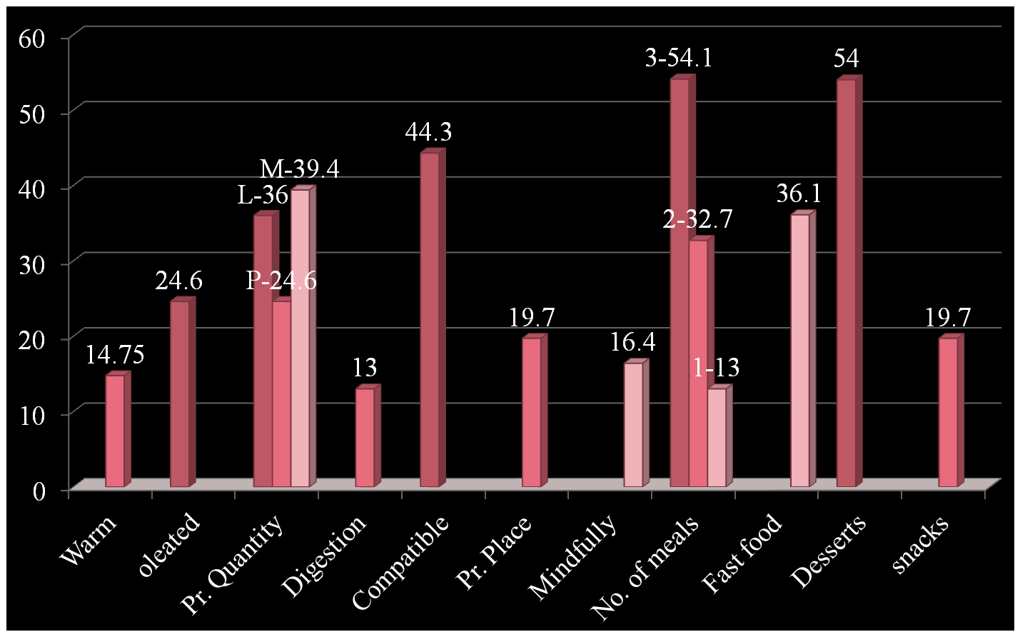
Ahara – Diet related Factors

Slide 9
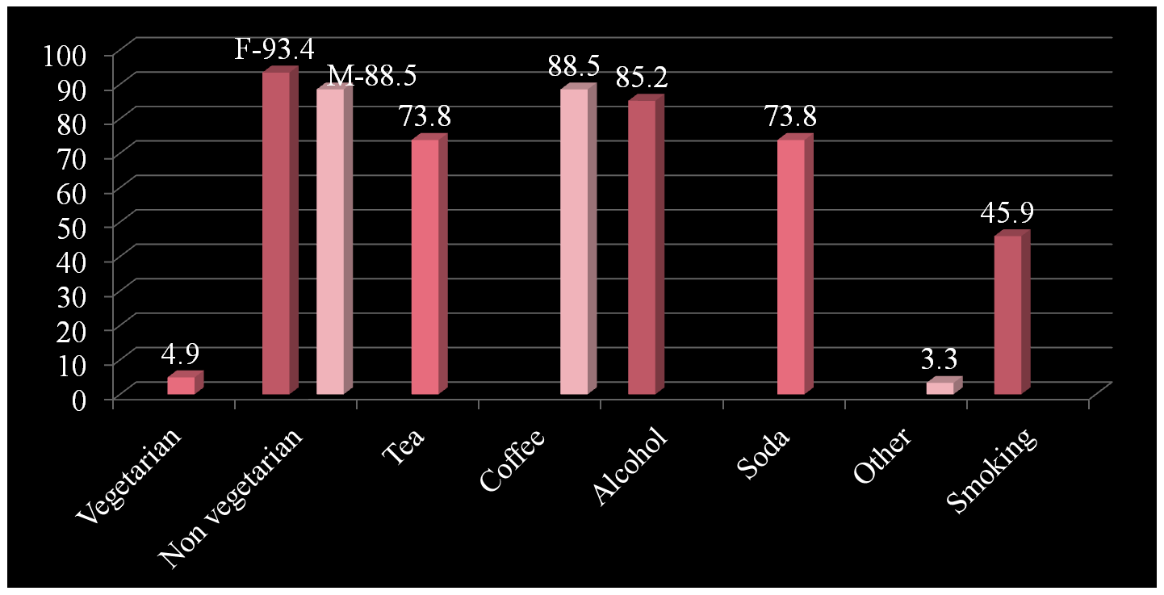
Ahara – Diet related Factors

Slide 10
Discussion
Eating warm, meals facilitates good digestion and timely evacuation
Quantity of food plays a major role in enzymatic action (Agni.)
The awareness about eating only when the previous meal is digested and eating compatible food stops the production of Ama (Bio-toxins) in the body
Heavy desserts, fast food like pizza and snacks between meals hampers digestive fire and creates Ama

Slide 11
Discussion
Tea, coffee, soda and other carbonated drinks creates addiction, hampers absorption of nutrients from gut, stimulates nerves and hampers digestive fire
The over use of alcohol negatively affects nervous system (Vata vitiation) and creates Ama
Smoking creates addiction due to nicotine contents and vitiates Vata

Slide 12
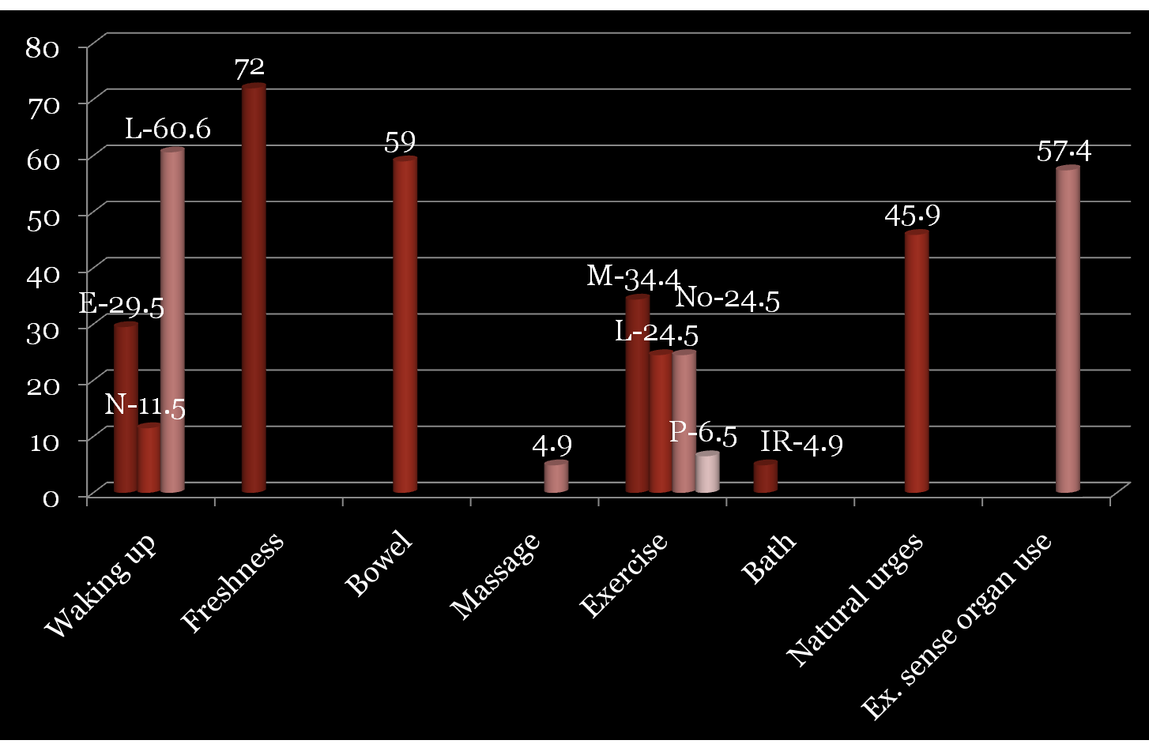
ViharaNa- Life style related factors

Slide 13
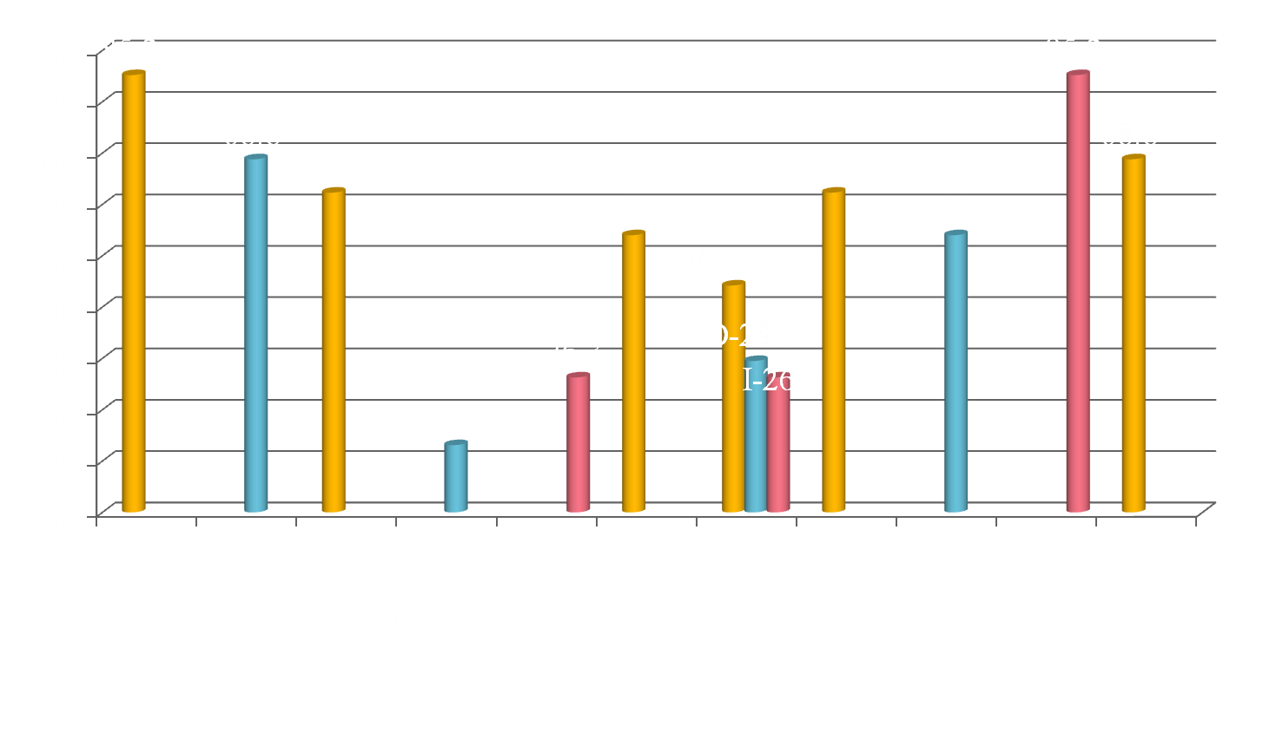
ViharaNA- Life style related factors

Slide 14
Discussion
Going to bed early and waking up early helps in total digestive and metabolic process- revitalizes the whole body
Daily massage exercise helps proper blood circulation
Excess physical work as well as mental stress lead to early degeneration
With holding natural urges and over use of sense organs, excess traveling, excess exertion lead to severe aggravation of Vata in body
Irregular eating and sleeping pattern will disturb the biological rhythm of body thereby creating Dosha vitiation and Ama production

Slide 15
Sadvritta- Psycho Spiritual practices

Slide 16
Discussion
Occupational worry out numbers all the other worries
Maximum number of patients were polite, well mannered and friendly. Spiritual out look towards life was not apparent.
Courage apparent. Tolerance not obvious
Lacking moderate attitude towards life and introspection.
Appeared less tolerant towards adversities and high level of psychological stress

Slide 17
Findings of Survey
Mental stress is greater than physical stress in majority
The lack of knowledge about nutritive factors of meal items prompts a person to chose incompatible food
Lack of rest/proper amount of exercise
Lack of knowledge about eye, ear, scalp care
Lack of knowledge and awareness about the religion and spirituality in life
Need for introducing and teaching proper daily and seasonal regime

Slide 18
Swasta Vritta
(life style for maintaining optimal health)
Dina Charya Daily regime
Ritu Charya
Seasonal alterations to the daily regime
Sadvritta Moral and spiritual conduct related to general and social living

Slide 19
Glimpse of Ayurvedic DINA Charya
Main components of Dina Charya | Meaning
ब्रह्मे मुहूर्ते उत्तिषम | Brahme Muhurte Uttishtam -Waking up before sunrise
मल निर्वर्तन | Mala Nissarana- Evacuating bowel
दन्त धावन /जिह्वा निर्लेखन | Danta Dhavana/ Jihva Nirlekhana- Cleaning teeth and tongue
अञ्जन सेवन | Anjana Sevana
नावन गण्डूष धूम ताम्बूल सेवन | Navana /Gandusha/ Dhuma. Tambula Sevana
अभ्यङ्ग एवं उद्वर्तन | Abhyanga Evam Udvartana- Body massage with oil and dry massage
व्यायाम | Vyayama- Physical Exercise
स्नान | Snaana- daily shower
सद्वृत्त सेवन | Sadvritta- good psycho –spiritual conduct

Slide 20
Glimpse of Ayurvedic Ritu Charya
Ritu | Seasons | Beneficial Regime
Shishir | Winter- Cold and dewy season | Sweet, sour and salt taste food, Wines, Wheat/gramflour products, milk products etc. Massage with oil, udvartana, exercise, exposure to sun etc.
Vaasanta | Spring season | Easily digestible food, Barley, honey, roasted meat, mango juice, fermented decoction etc. Physical exercise, Udvartana, avoid day sleep.
Grishma | Summer season | Sweet, light, fatty and liquid food ,syrups, boiled rice with meat, corn flour,etc Applying sandalwood, wearing thin cloths and staying in cool places.
Varsha | Rainy season | Easily digestible food ,meat juice, soups, old grains etc and avoid exposure to sun, wetness of rain,cold etc.
Sharat | Autumn season | Bitter, astringent and sweet taste , rice, green gram, honey and sugar etc.
Hemanta | Pre-Winter season | Same as of winter.

Slide 21
sadvritta
Ethical code of conduct | Social code of conduct | Moral code of conduct
Always speak the truth. • Don’t get addicted to sensory pleasures. • Have a positive attitude. • Don’t harm anyone. • Control your passion. • Endeavor to speak pleasantly and be kind to everyone. • Be polite and courteous. • Meditate every day. • Be patient and observe self control. • Share your knowledge with others. • Do good to self and society. • Serve God and elderly. | Talk politely and respectfully to the listener using appropriate words that benefit self and others. Never contradict the teacher even if he/she is angry. Never insult a person who is inferior to you. Don’t be jealous of anyone. Help the poor, be courteous to them. Undertake an activity after considering its long term effects. | Avoid company of bad people. Keep a balance between happy and unhappy conditions. Always try to forgive. Think of betterment of all creatures. Help the poor, underprivileged, or diseased people. Do good deeds. Contribute your wealth and energy for the betterment of society.

Slide 22
Conclusion
Increase in negative environmental factors
Allergies, neuropathies and many other new diseases crop up frequently
Ayurvedic Swastha Vritta is an ideal ways of balancing mental and physical aspects of a human being thereby preventing and minimizing health hazards
Collaborative research in preventive aspects of Ayurveda could be sterngthened.

Slide 23
Follow up AND Suggestions for further research
Assessment of positive out come of the advice /intervention provided to the survey group
Assessment of the out come of the given advice in non-comunicable disease conditions
Standard recording and revalidating the effects for improving the health care advice

Slide 24
Suggestions for further research CONTD
Prospect of conducting similar survey in different localities in Sri Lanka
Utilization of such survey findings in re-introducing the ancient wisdom of Ayurveda medicine in the health care system of Sri Lanka

Slide 25

Thank you

